Slide 1
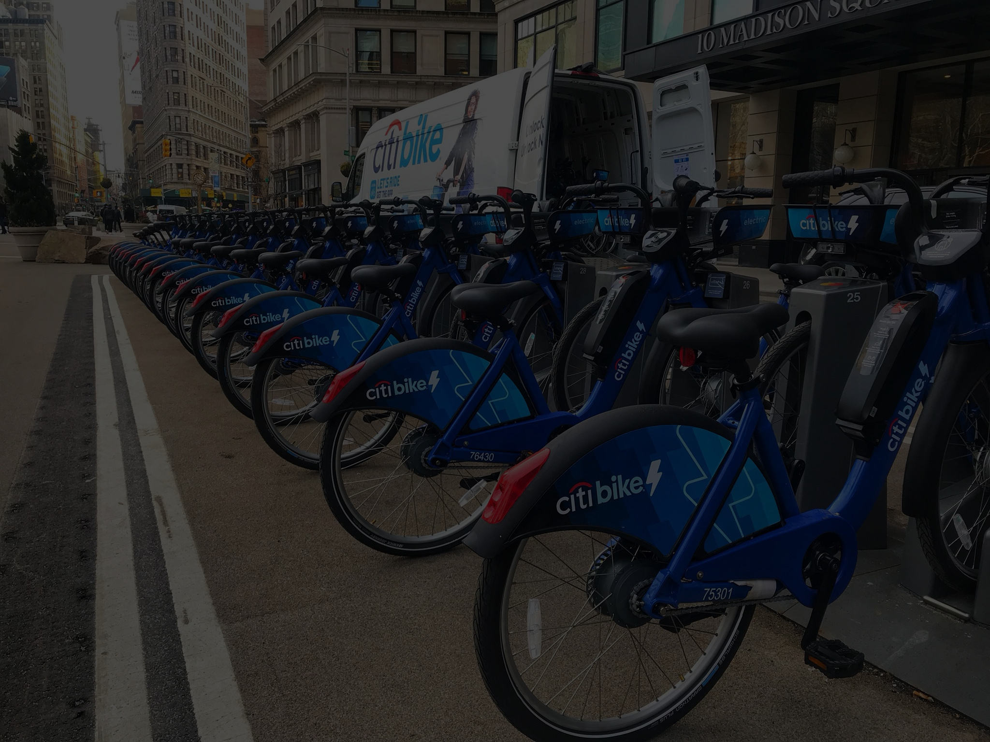
DATA ANALYSIS
CITIBIKE
2 APRIL 2025

Slide 2
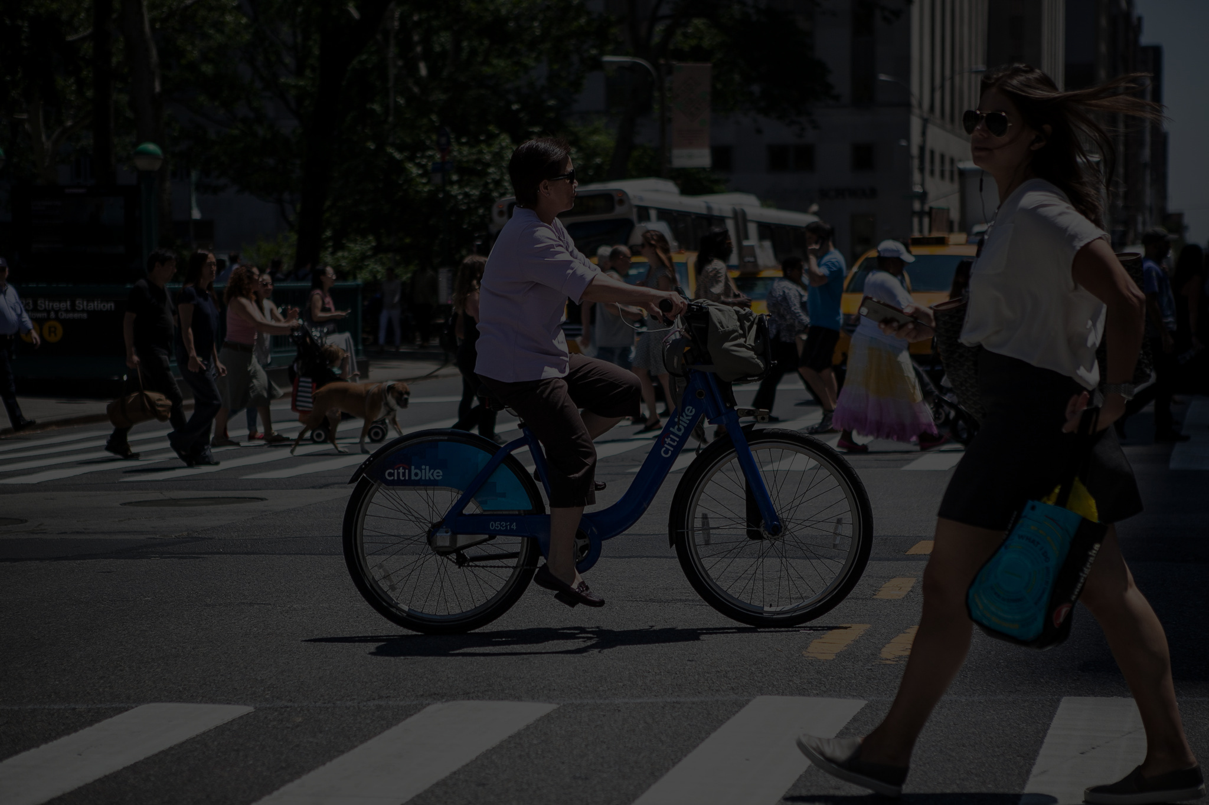
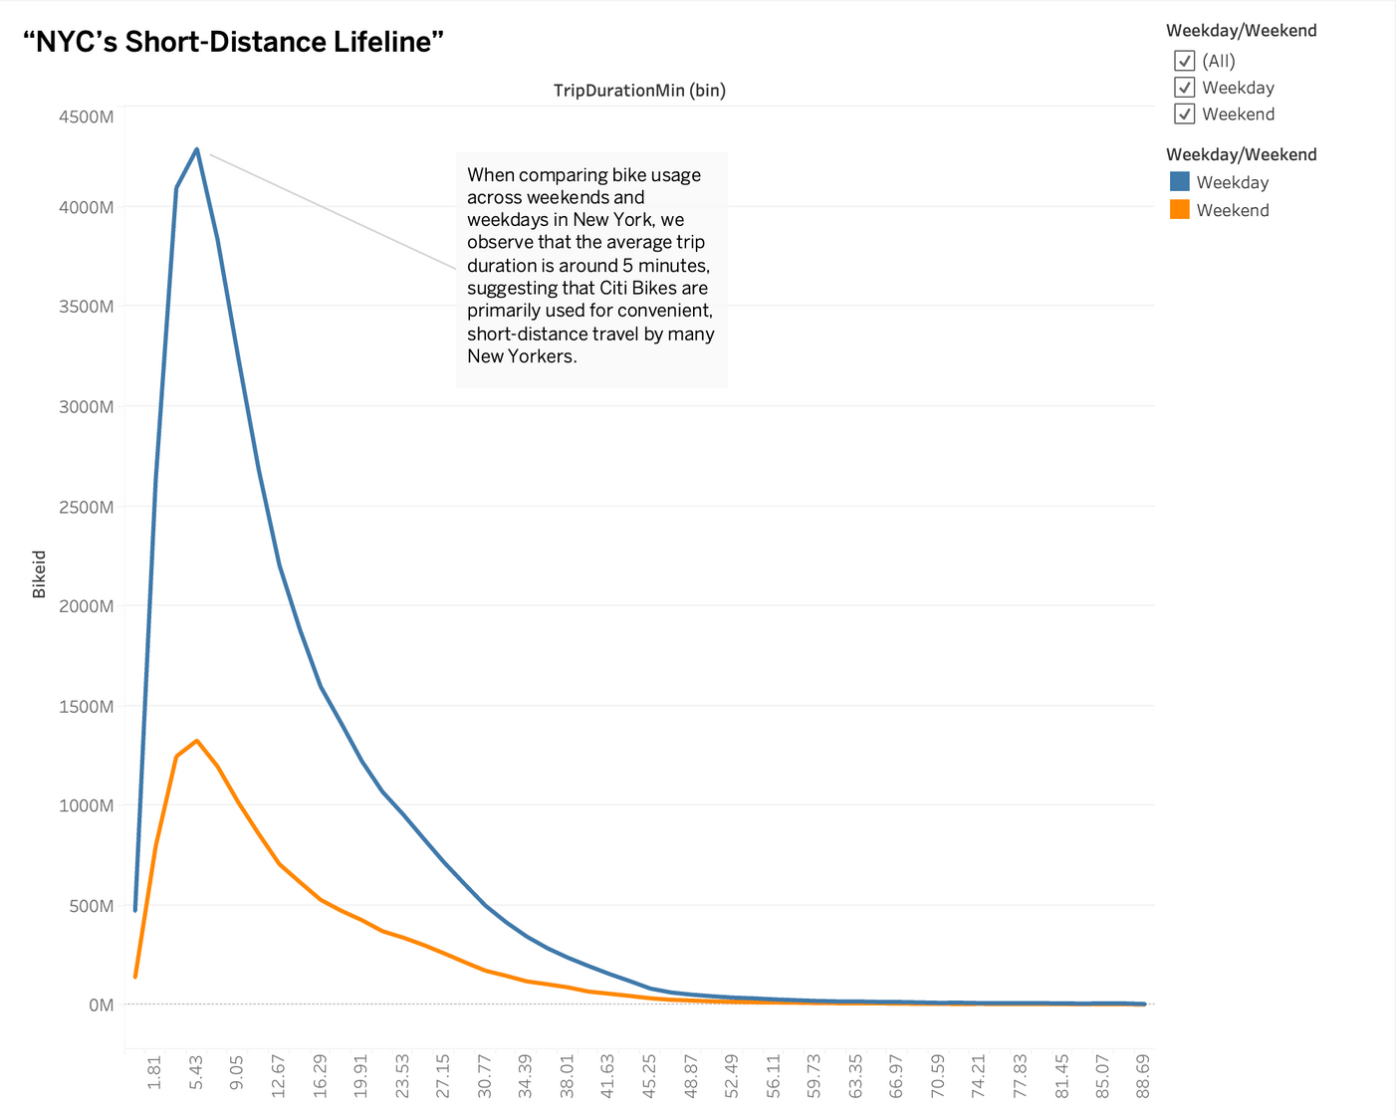
CONTEXT
CITIBIKE IS NYC'S LIFELINE FOR SHORT-DISTANCE TRAVEL. BUT WHEN EXACTLY DO PEOPLE RIDE? UNDERSTANDING DAILY PATTERNS COULD MAKE OR BREAK OPERATIONS.
“Now that we know Citi Bikes are essential for short trips, when exactly do people ride the most?”
OUR GOAL: HELP CITIBIKE OPERATE SMARTER.

Slide 3

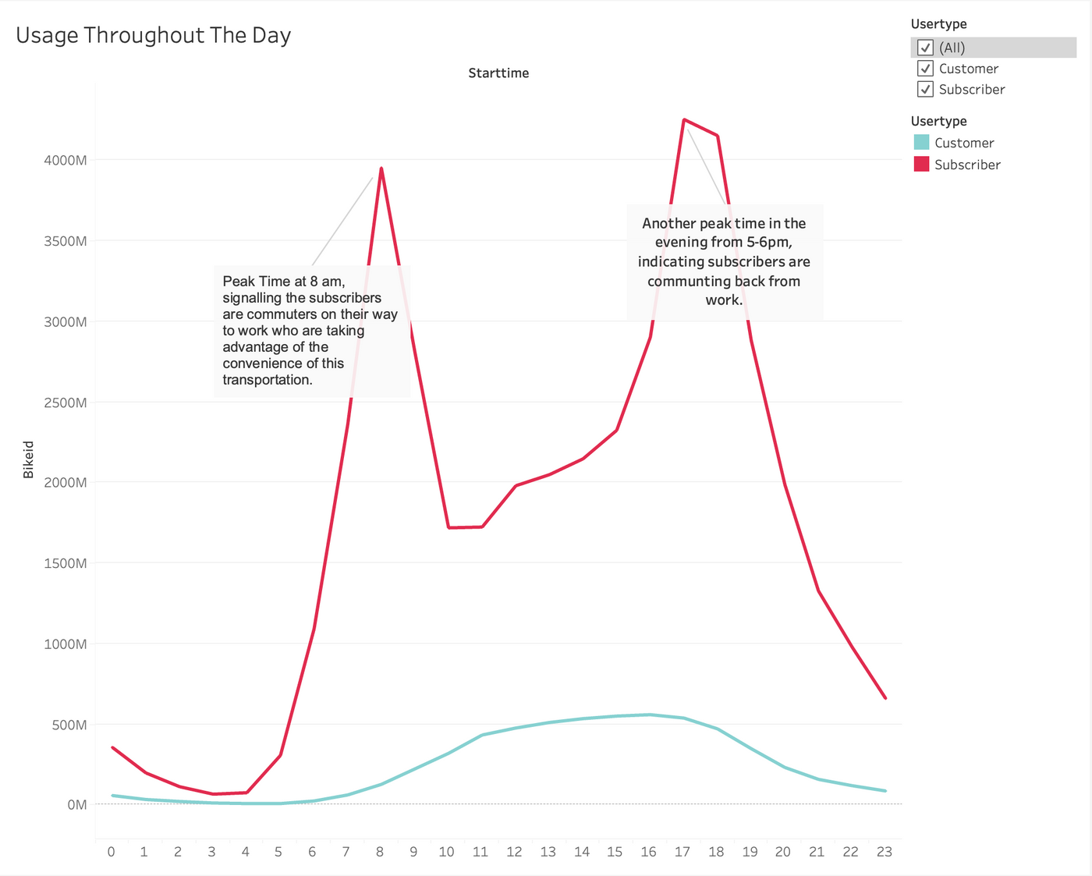
SYSTEM USAGE BY HOUR
WHAT STANDS OUT IS THE QUIET WINDOW BETWEEN 1 AM AND 5 AM. THIS LOW ACTIVITY PERIOD IS IDEAL FOR SYSTEM MAINTENANCE OR UPDATES.

Slide 4
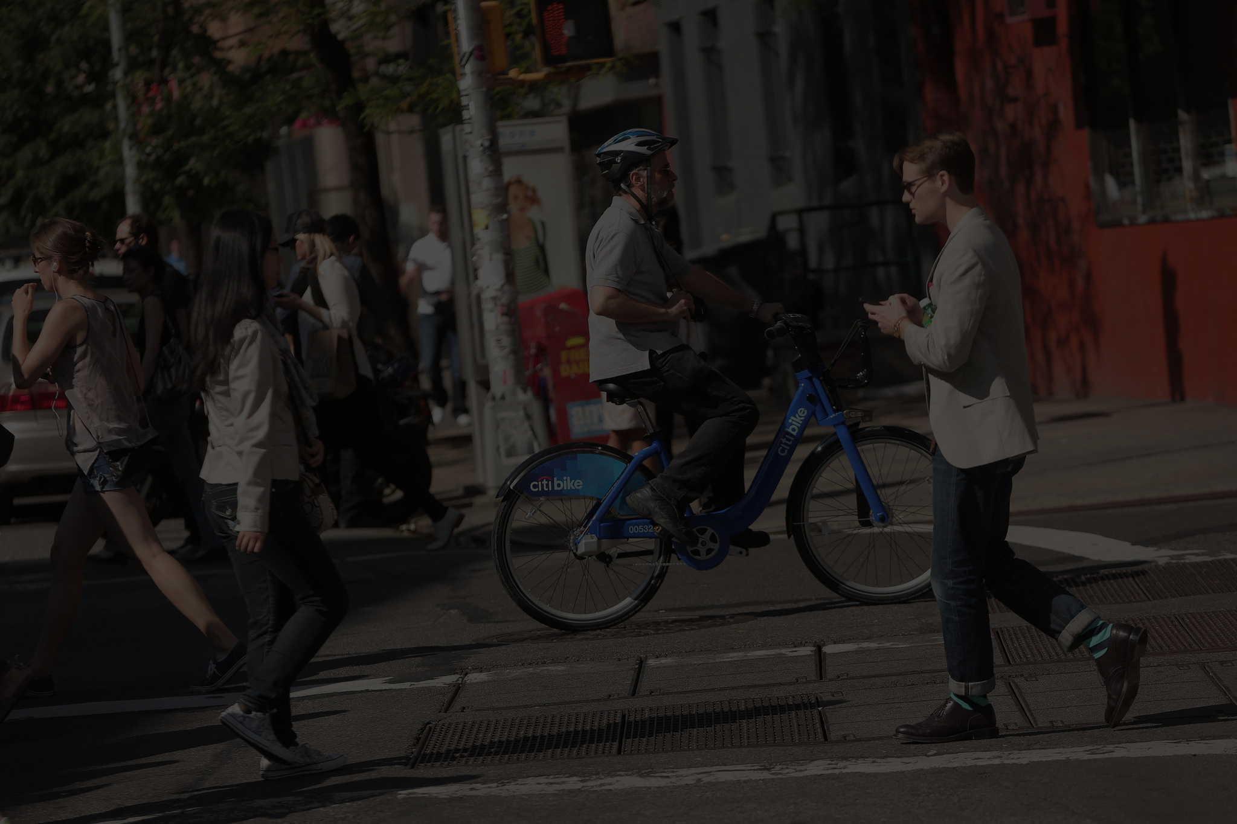
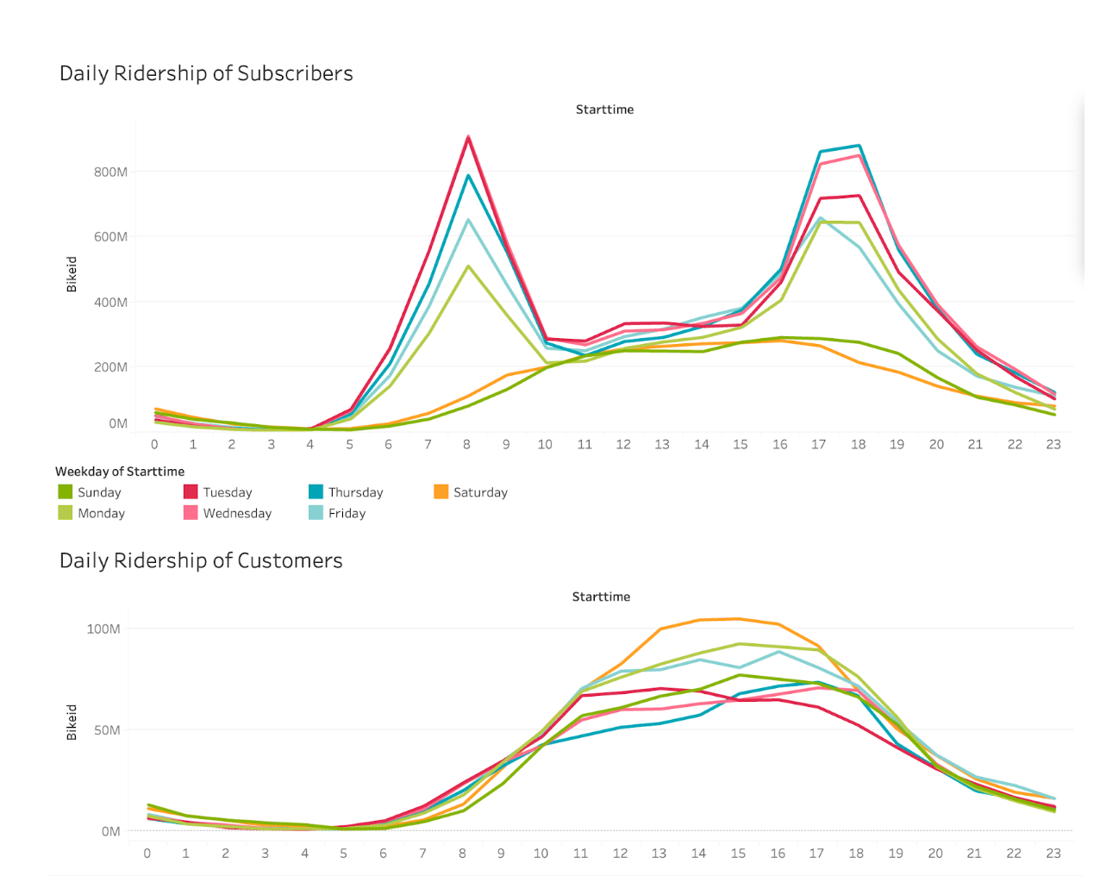
WEEKDAY VS WEEKEND PATTERNS
“Recognizing these patterns helps Citi Bike optimize bike availability by redistributing bikes based on daily demand, ensuring they are placed where they’re needed most.”

Slide 5
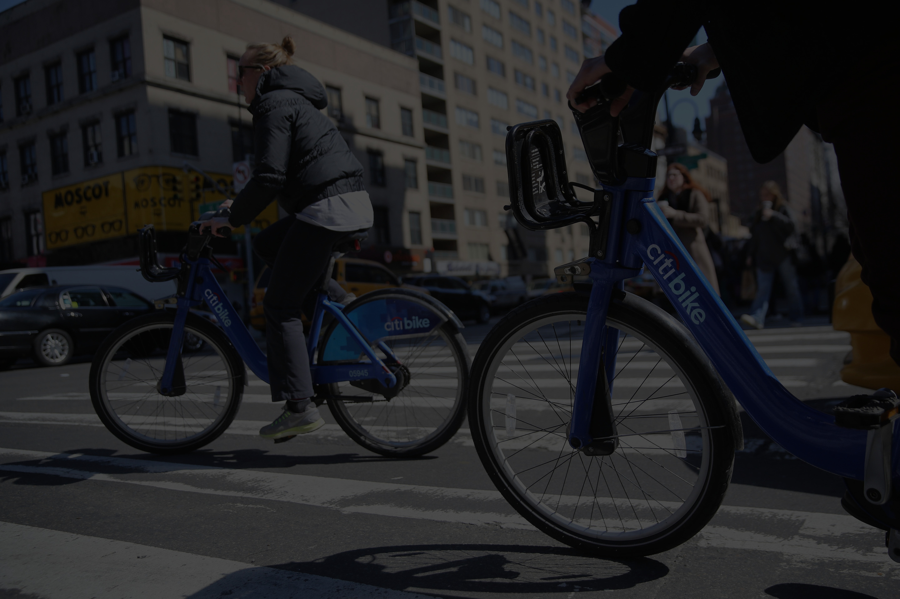
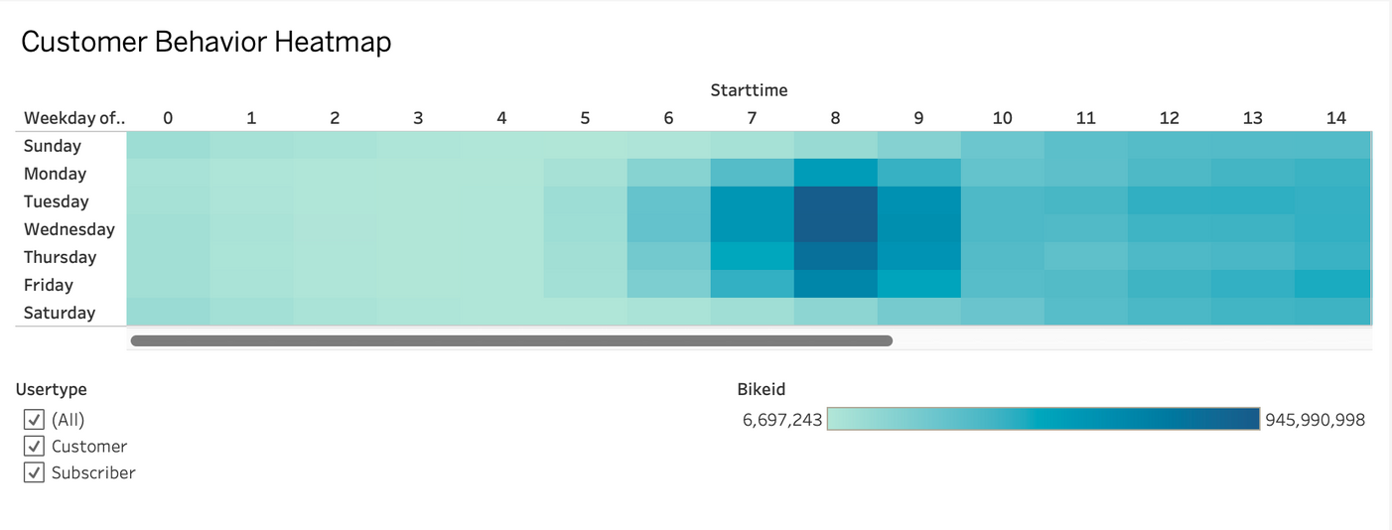
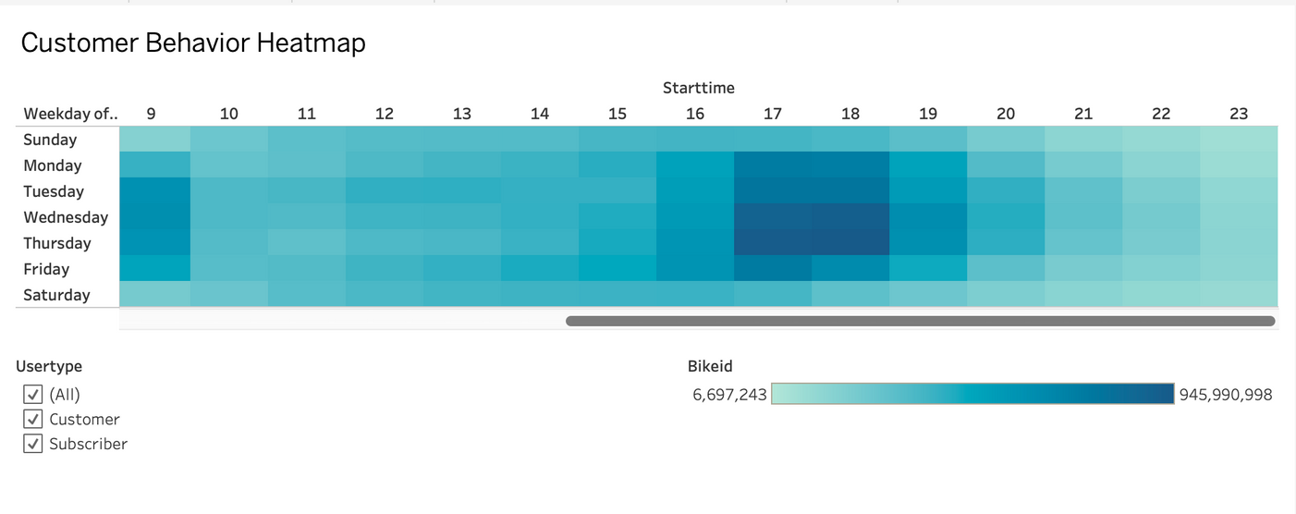
CUSTOMER BEHAVIOR HEATMAP
UNLIKE SUBSCRIBERS, CUSTOMERS AVOID PEAK COMMUTE HOURS, SUGGESTING THAT THEIR RIDES ARE MORE SPREAD OUT AND LESS PREDICTABLE.
CUSTOMERS MAY AVOID RUSH HOURS DUE TO HIGH TRAFFIC AND LOWER BIKE AVAILABILITY. INDICATING THEY MOSTLY USE IT FOR LEISUR

Slide 6
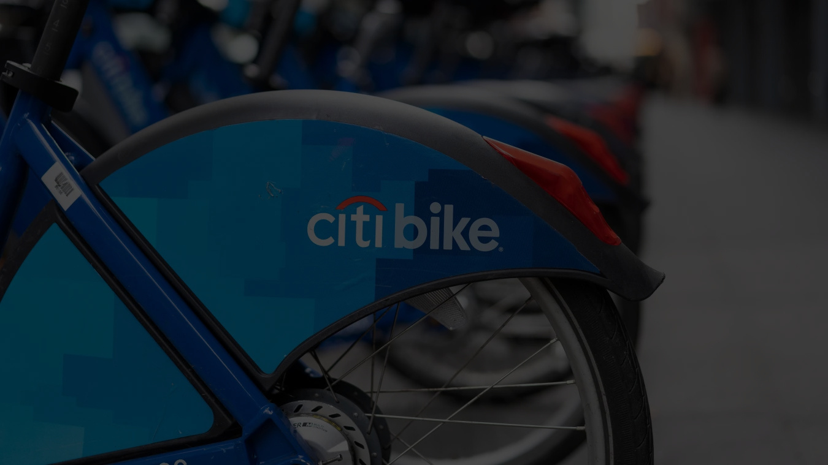
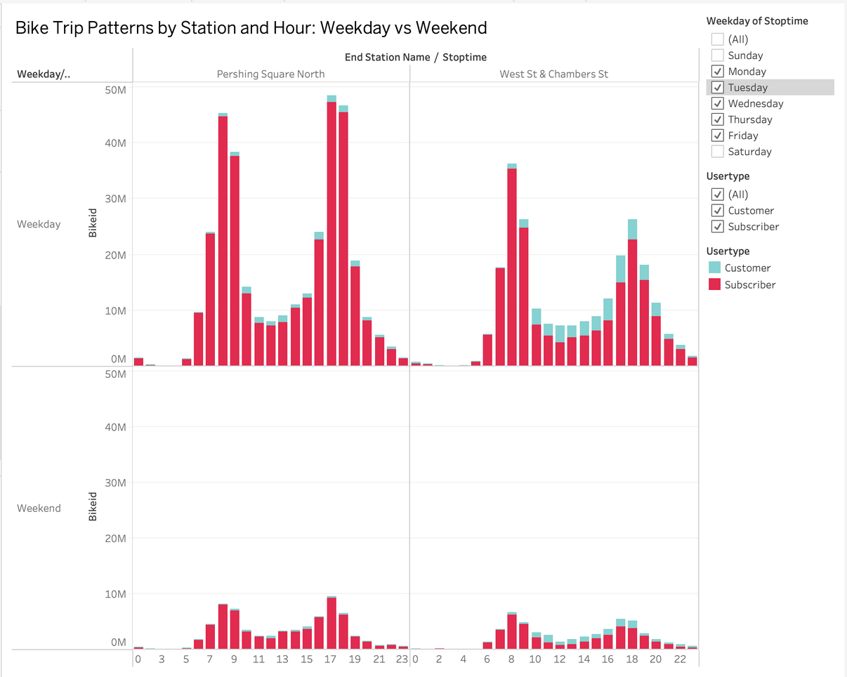
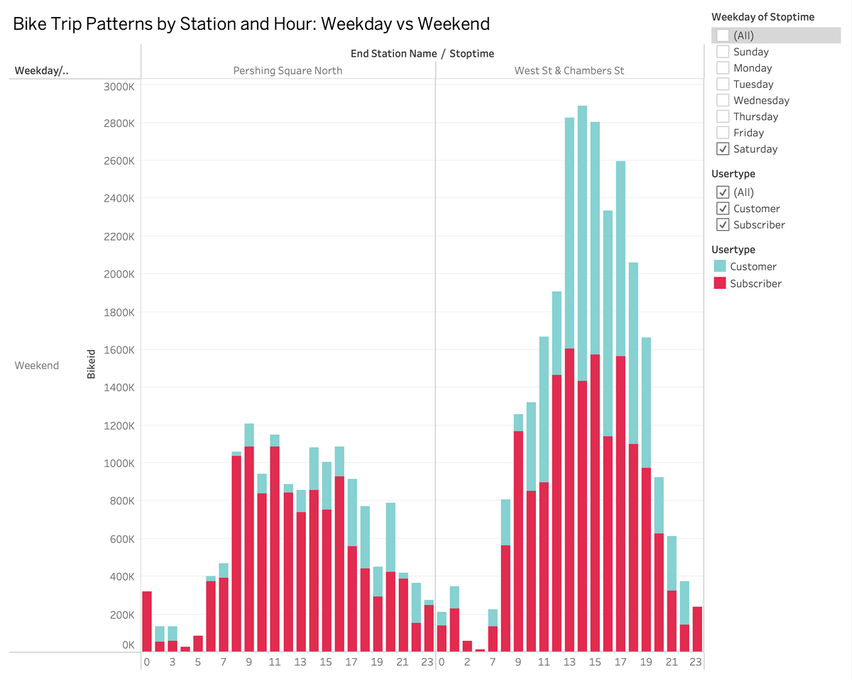
INCOME RAISE
ON WEEKDAYS, WE NEED ENOUGH BIKES FOR COMMUTERS IN THE MORNING AND EVENING. ON WEEKENDS, WE NEED STEADY AVAILABILITY ALL AFTERNOON TO MEET CUSTOMER DEMAND

Slide 7
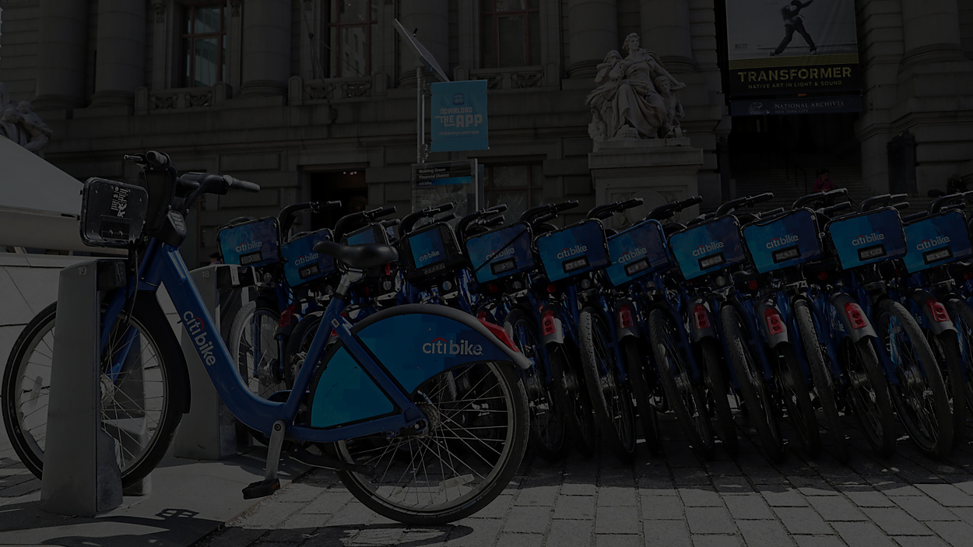
RECOMMENDATION
CITIBIKE
1
2
MAINTANCE HOURS
TARGTED PROMOTIONS
Schedule maintenance between 1 AM and 5 AM when ridership is lowest, minimizing disruption.
Leverage targeted promotions and flexible pricing to attract more casual riders and maximize off-peak usage.
3
4
AVAILAIBILTY AT KEY STATIONS
STEADY FLOW FOR CUSTOMERS
Increase bike availability at key commuter stations during rush hours to meet subscriber demand.
Maintain a steady flow of bikes for weekend explorers, ensuring tourists and casual riders have easy access.

